Slide 1
Lattice Dynamics
By :- Shivansh Jaiswal(B20MT041)
Supervisor: Dr. Appala Naidu Gandi
Department: Metallurgical and Materials Engineering

Slide 2
Contents
Vesta Software
Work done using vesta
What is lattice Dynamics
Lattice Vibrations
Phonons
Phonon Dispersion Relation
Force Constants
2-nd Order force Constants
Hamonic Approximation
PHON: A program to calculate phonons using the small displacement method
Theoretical Aspect of the program
Basic Linux Commands
Exercise to find optimal lattice parameter using Linux

Slide 3

Vesta
Visualization for Electronic Structural Analysis (Vesta) is a 3D visualization program for structural models, volumetric data such as electron/nuclear densities, and crystal morphologies.
It helps us to improve our visualization of the structures

Slide 4
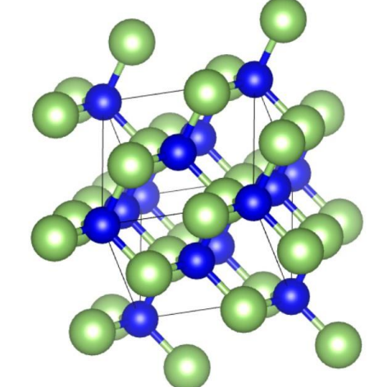
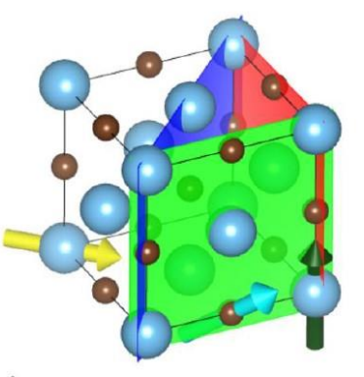
Work done using the vesta Software
Making a unit cell : GaAs
Making a unit cell, atomic planes and direction:

Slide 5
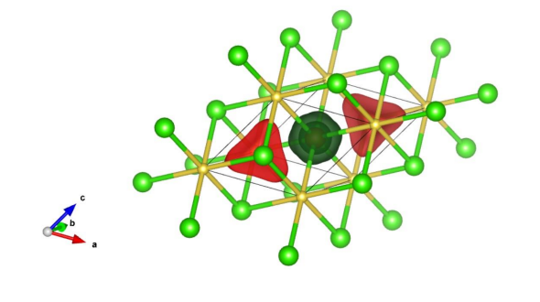
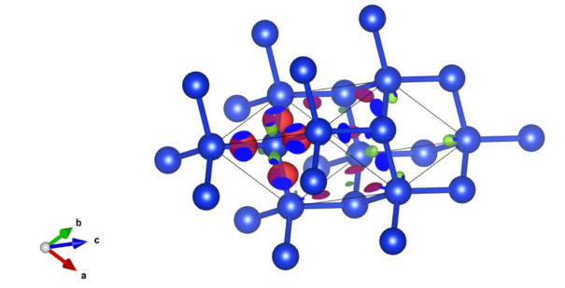
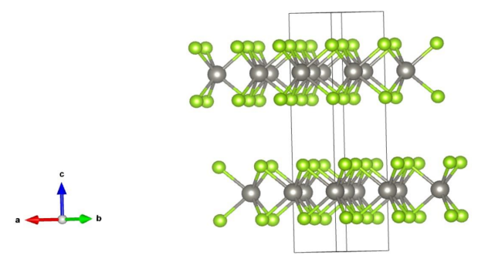
Charge Density of NaCl structure using vesta:
Charge density of Si atom using vesta:
Making 2H variant Crystal of WSe2:

Slide 6
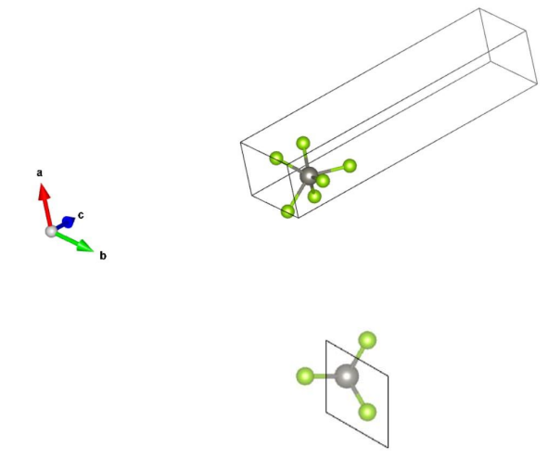
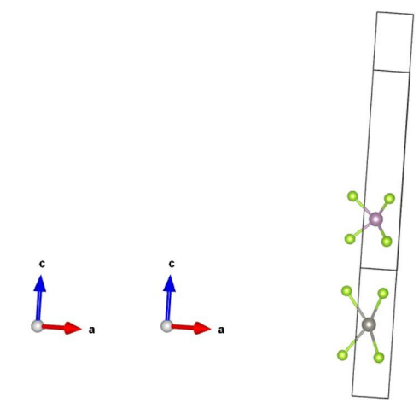
Monolayer formation of WSe2:
Combining two monolayers MoSe2_WSe2:

Slide 7
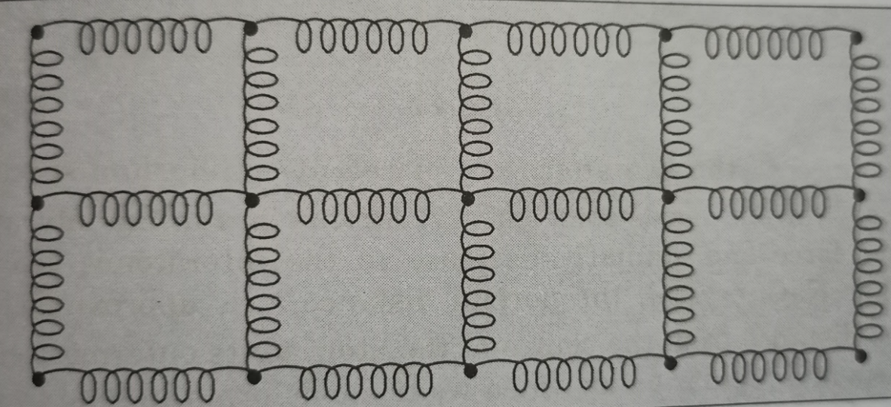
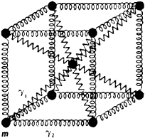
What is Lattice Dynamics
Lattice Dynamics is the Study of the vibration of the atom in a crystal lattice.

Slide 8
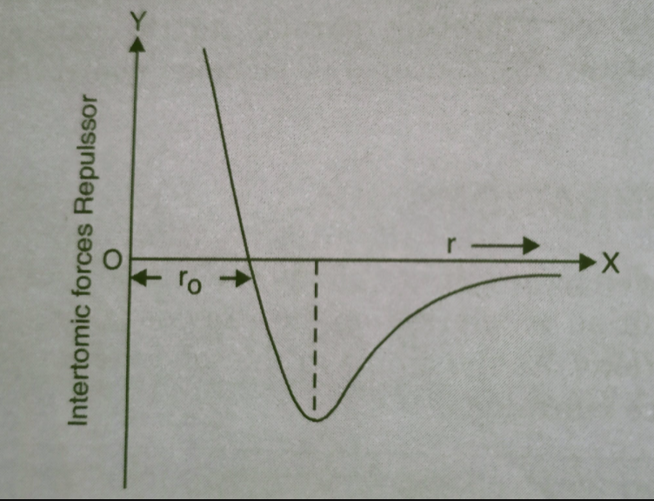
Lattice Vibratiations
Every atom has a tendency to vibrate about their mean position at temperature above zero Kelvin.
The mean position is referred as the Bravais lattice site. These vibrations occur due to interatomic interactions.
As the atoms in the solids are present at lattice sites , so these vibrations are called lattice vibrations.

Slide 9
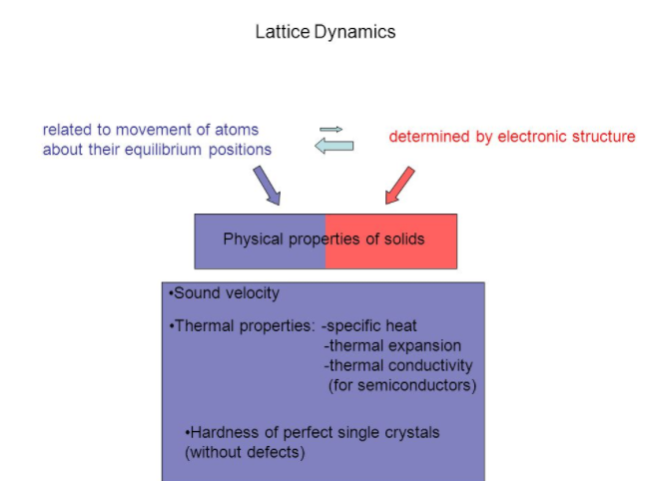

Slide 10
Phonons
A unit of vibrational energy that arises from oscillating atoms within a crystal.
A packet of these waves can travel throughout the crystal with a definite energy and momentum, so in quantum mechanical terms the waves can be treated as a particle, called a phonon.

Slide 11
Phonon Dispersion Relations
The phonon dispersion relations are defined as the k dependence of the frequencies,
ω(k,j), of the normal modes for all branches j and selected directions in the crystal.

Slide 12
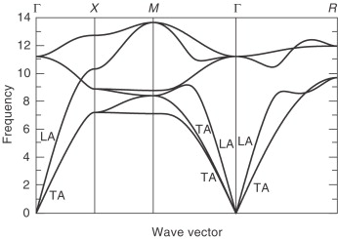

Slide 13
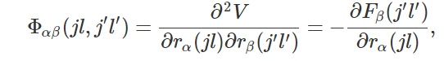
Force Constants
A force constant defined as a second energy derivative relative to internal coordinates near the equilibrium position, Fij = d2E/dqi*dqj, is obtained most simply by the double differentiation in various points of the two-dimensional grid of qi and qj values.

Slide 14
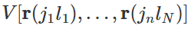
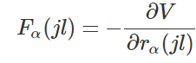
2nd-order force constants
Potential energy of phonon system is represented as functions of atomic positions:
The second order force constants is given by:

Slide 15
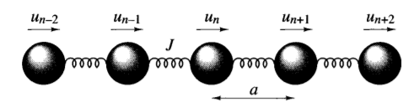
Harmonic Approximation
The key approximation in the theory of lattice dynamics is the harmonic approximation. In this we consider all atoms of a lattice to attached using a spring and have harmonic motion, this allows us to perform calculation easily.
These include the link between vibrational frequencies, wave vector and interatomic forces, and applications in areas such as the thermodynamic properties of materials.

Slide 16
PHON: A program to calculate phonons using the small displacement method
The program PHON calculates force constant matrices and phonon frequencies in crystals. From the frequencies it also calculates various thermodynamic quantities, like the Helmholtz free energy, the entropy, the specific heat and the internal energy of the harmonic crystal.
The procedure is based on the small displacement method, and can be used in combination with any program capable to calculate forces on the atoms of the crystal. In order to examine the usability of the method, here two examples: metallic Al and insulating MgO.

Slide 17
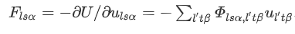
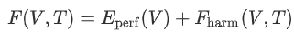
Theoretical aspects Phonons in a crystal
Consider a crystal at very low temperature and expand the potential energy function around the equilibrium positions of the nuclei.

Slide 18
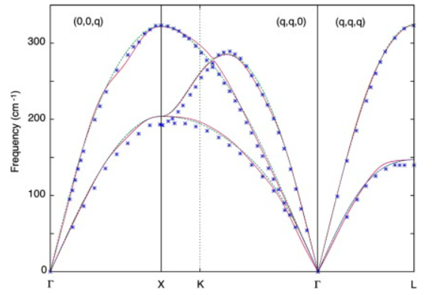
Phonon dispersion relation calculated by using the phon of Al

Slide 19
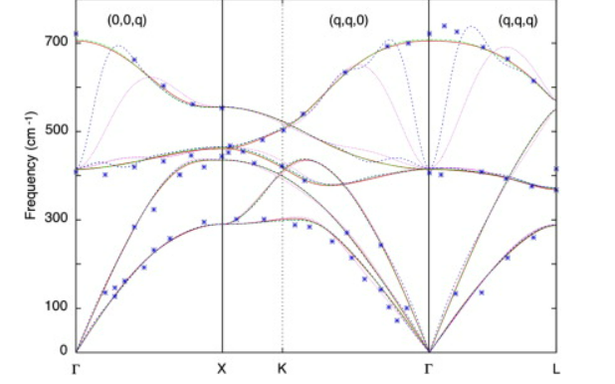
Phonon dispersions of MgO

Slide 20
In order to calculate the energy we assume that the potentials are treated as the harmonic potentials, this assumptions is valid as long as the atoms remain close to equilibrium position.
The expression for potential is obtained by using the Taylor's expansion and we found that the potential is proportional to displacement square and gives the quadratic term.
Higher order terms are neglected as we as assuming the displacement about there mean position to be less.

Slide 21
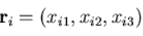
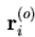
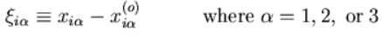
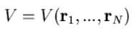
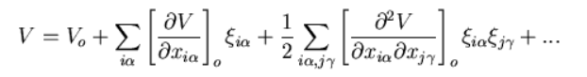
Understanding the expression in depth
Consider a solid consisting of N atoms, each of mass mi, with position The equilibrium position is Each atom can vibrate about its equilibrium position. The displacement from the equilibrium position
Since the displacements are small, we can expand the potential energy taylor’s series

Slide 22
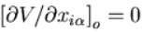
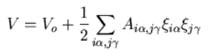
In the expression I and j go from 1 to n; and alpha and gamma go from 1 to 3.
The derivatives are evaluated at the equilibrium positions of atoms.
The first term Vo is the potential energy when the atoms are in their equilibrium configuration.
Since Vo is the minimum value of V the first derivative must be equals to zero.
That is there is no force on any atom in the equilibrium configuration. So the first term in the Taylor series vanishes and we get the expression
It can also be given as:

Slide 23
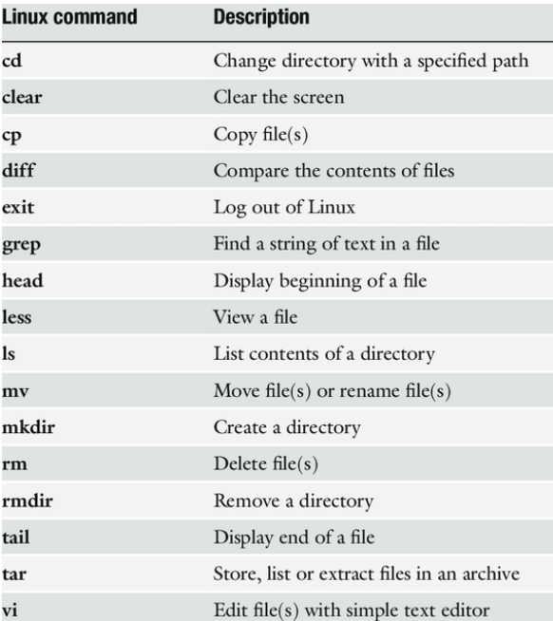
Basic Linux Commands

Slide 24
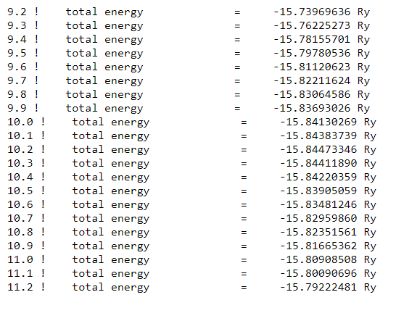
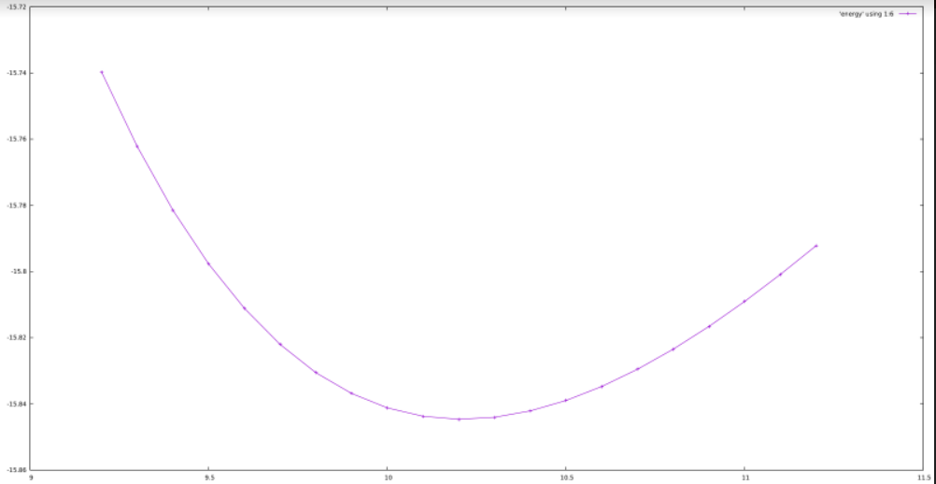
Exercise to find the optimal lattice parameter using Linux

Slide 25
Thank You

